Slide 1

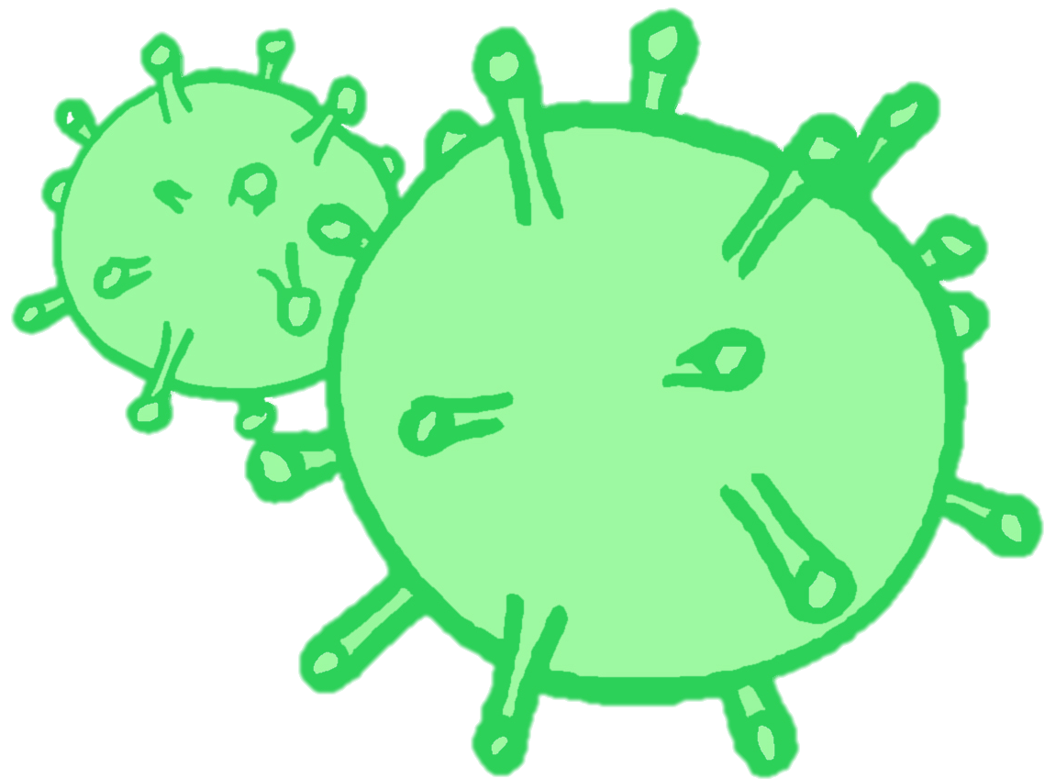
CONTRACEPTION & STI’s
Year 10 Health Lesson 7 + Lesson 8 Term 2, 2024

Slide 2

Today’s Focus
Complete Task 3: STI Oral Presentation.
**Week 8 = exam break**

